Slide 1
Monitoring for Streams Stagnancy
Eric Boyce
Business Intelligence Senior Oracle DBA
Colorado Community College System

Slide 2
Why Monitor?
Monitoring latency and throughput of streams gives us a good indication as to the health of streams processes
While the STAGE_AREA_STATUS job is invaluable, it doesn’t display in real terms what the latency is for streams.

Slide 3
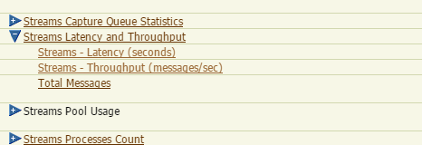
Grid Monitoring?
If an institution has Grid Control, metrics and corresponding alerts can be controlled to send alert emails.
Grid Control can go down, however, and there should be a back up method to assure that streams doesn’t fall hopelessly behind in such a scenario.

Slide 4


DBMS_SCHEDULER Job
By monitoring streams latency using a DBMS_SCHEDULER job we can augment the STAGE_AREA_STATUS data, and backup existing Grid Control/EM alerts (if applicable)

Slide 5
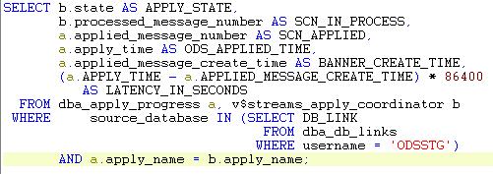
CCCS_SCN_MONITOR
Driven by the query below. Note that we’re calculating the latency between the Banner side message create time and the time at which it was actually applied to ODS. This is the APPLY latency.
Source: Oracle Streams 11g Replication, Deshpande

Slide 6
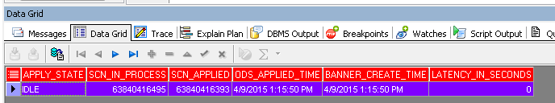
Results

Slide 7
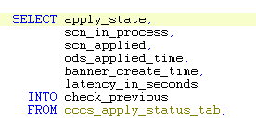
Putting it all together
We now know the latency of the apply process, but without hard-coding the interval in which the procedure/job is executed, we are unable to determine if we are stagnant.
Store the values in a table so we can view previous run data.

Slide 8
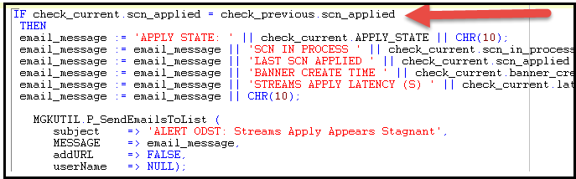
Comparison and Email
By comparing the current scn_applied value and the previous scn_applied value we can determine if the Apply process is stagnant.
We then build an email body with values we’re concerned about and send an email to ODS Administrators

Slide 9
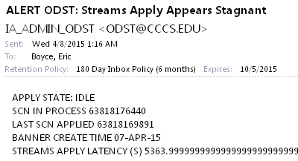
Example of an Alert Email

Slide 10
Questions?
Email: eric.boyce@cccs.edu

